Slide 1
Economic Outlook
HBA of Greater Springfield
November 21, 2024

Slide 2
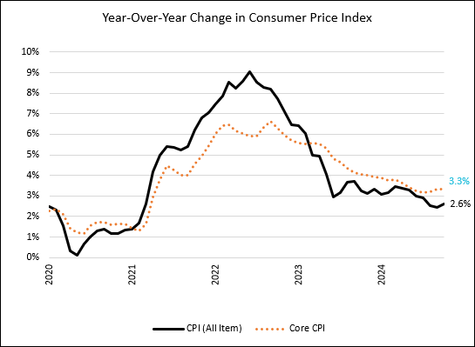
Economy is Normalizing: Inflation
After spiking in 2022, inflation has slowly retreated.
The October inflation rate was 2.6%.
This is still above the Fed’s target of 2%, but there is a belief that the downward trend will continue.
Source: Bureau of Labor Statistics

Slide 3
Fed Hiked Interest Rates to Fight Inflation

Slide 4
Where Will This Leave Mortgage Rates?

Slide 5
Economy is Normalizing: Gross Domestic Product
GDP remained mostly strong post-pandemic.
Source: Bureau of Economic Analysis

Slide 6
Economy is Normalizing: Employment
We are seeing a clear slowing in the rate of job creation relative to a few years ago. But even the slower pace we have seen in 2024, is above pre-pandemic levels (2018-2019) 2018-19 179,000 a month 2024 thru Sept. 200,000 a month
Source: Bureau of Labor Statistics

Slide 7
The Economy Did Undergo Some Change
Overall employment growth was up 4%.
Some industries saw some significant change.
Transportation &Warehousing +14%
Professional, Scientific Tech. Svcs. +7%
Manufacturing growth was modest, but it had lost over 3 million jobs since 2001.
Source: Lightcast

Slide 8
Manufacturing Construction Boom
There has been an unprecedented jump in investment in U.S. manufacturing.
Source: U.S. Census Bureau

Slide 9
Missouri Employment Has Been Strong
For the year ending October, Missouri has added 81,700 jobs.
Only 5 states have added more.

Slide 10
Missouri’s Economy Changed as Well
Outpaced the U.S. in manufacturing, construction, finance.
Kept pace in transportation, information, health.
Fell behind in professional-business services. (Prof-tech, Mgmt. of Companies, Admin and Support).

Slide 11
Missouri’s Economy Changed as Well

Slide 12
Springfield MSA Employment by Industry

Slide 13
Springfield MSA Employment Change by Industry

Slide 14
Springfield MSA Industry Specialization

Slide 15
Springfield Home Values Spiked 2020-22

Slide 16
Missouri MSA Home Value Comparison

Slide 17
Springfield Population Trends

Slide 18
3 Key Takeaways
The economy is normalizing and should continue to do so into 2025.
We have seen changes in the industry mix nationally.
Missouri and the Springfield Area are in (mostly) in a good position to benefit from this shift.

